Slide 1

Paper summarization & simulation of
Characterization and Modeling of Low Frequency Noise and
Dielectric Traps in Scaled MOSFET Devices
Seham Nasr

Slide 2

Outlines
Background
Problem that this paper solve
Scope of this research
Goals
Methodology of this paper
Main algorithm
How this paper solve the challenges
Results and discussion
Future work

Slide 3
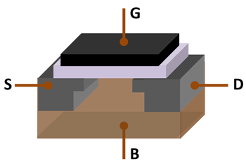
Background
The metal-oxide-semiconductor field-effect transistor (MOSFET) is a key semiconductor component, the heart and brain in almost all electronic circuits, the evolution of which has stimulated the recent explosion in information and communication technology.
MOSFET, showing gate(G), body (B), source (S) and drain (D) terminals. The gate is separated from the body by an insulating layer

Slide 4
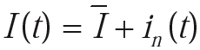
Cont.
True noise in an electronic device is a random, spontaneous perturbation of a deterministic signal inherent to the physics of the device. Noise is a principal issue in science and engineering. True noise, cannot be eliminated, but it is possible to reduce it by proper design of the devices and circuits. Equation below illustrates how an electronic signal fluctuates randomly due to noise. The current through a device can be written as
where I is the average bias current and in(t) is a randomly fluctuating
current. The value of in is random at any point in time and cannot be
predicted.
Notes:
The frequency range for low-frequency noise measurements is typically from 1 Hz to 1 MHz.

Slide 5
Cont.
The noise sources in a MOS transistor are:
thermal noise in the channel
Low frequency noise ,or 1/f noise (flicker noise)
Noise in the resistive poly gate
noise due to the distributed substrate resistance
shot noise associated with the leakage current of the drain source reverse diodes.
The flicker noise study in semiconductors started even before the development of the MOSFET
flicker noise is a type of electronic noise with a 1/f power spectral density. It is therefore often referred to as 1/f noise. It occurs in almost all electronic devices and can show up with a variety of other effects, such as impurities in a conductive channel, generation and recombination noise in a transistor due to base current, and so on.
Notes:
MOSFETs have a higher f_{c} (can be in the GHz range) than JFETs or bipolar transistors, which is usually below 2 kHz for the latter.
1/f noise has been observed in all kind of devices, from homogeneous metal film resistors and different kind of resistors to semiconductor devices and even in chemical concentrated cells.
Shot noise happen when you have distenict transition event of a charge carrier

Slide 6
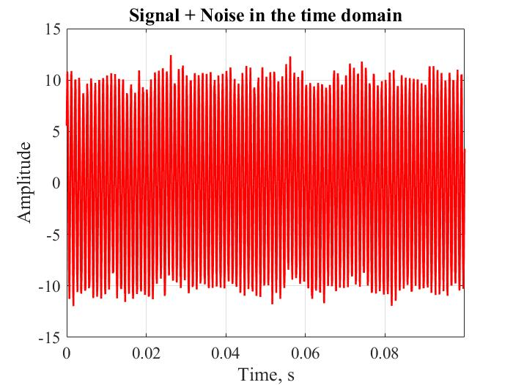
Cont.

Slide 7
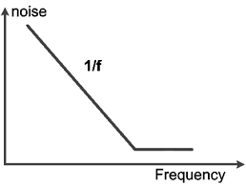
Cont.
flicker noise origin is one of the oldest unsolved problems in physics. It is pervasive in nature and in many human endeavors. It is present in all active and many passive devices. It may be related to imperfections in crystalline structure of semiconductors, as better processing can reduce it.
characteristics of flicker noise:
1/f noise increases as the frequency
decreases, which makes it significant to study
It is associated with a DC current in electronic
devices.
It has the same power content in each
octave (or decade).
The MOS transistor has the highest 1/f noise
of all active semiconductors, due to their
surface conduction mechanism.
Its origin is found to be related to traps in the gate dielectric.
Spectrum of low frequency or “1/f ” noise versus frequency

Slide 8
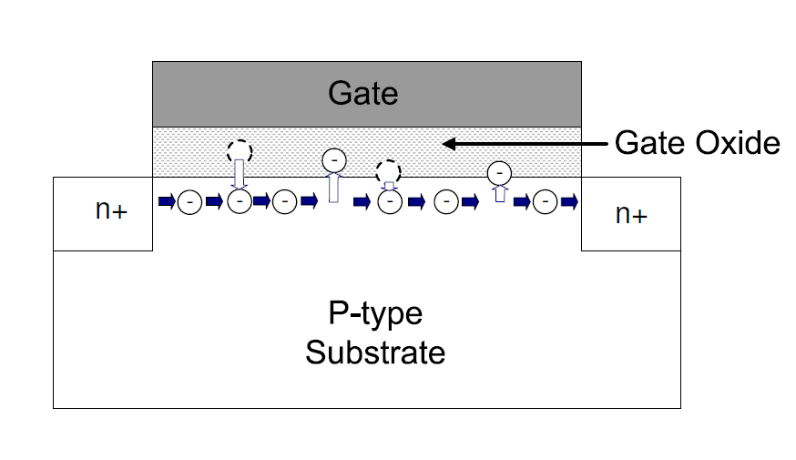
Cont.
There are two theoretical methods of low frequency or 1/f noise:
the carrier number fluctuation model
the bulk mobility fluctuation model
Cross-section of the MOSFET depicting the trapping and detrapping of the electronics in the channel from oxide traps.
As the area of the MOSFET is scaled below 1 um2, where there is only one or
two traps detected to participate in the drain current fluctuation at the time of measurement, a phenomenon called random telegraphy noise (RTS) can be
observed.
Notes:
In the carrier number fluctuation theory, the flicker noise is attributed to the random trapping and de-trapping processes of charges in the oxide traps near the Si-SiO₂ interface. The charge fluctuation results in fluctuation in the channel carrier density, which in turn modulates the drain current
In the mobility fluctuation theory, on the other hand, the current level increases/decreases as a result of the fluctuation in bulk mobility.
The number fluctuation model states that the random trapping and detrapping processes of charges in the oxide traps near the
dielectric-semiconductor interface results in surface potential fluctuations, which in turn modulates the channel carrier density.

Slide 9
Cont.
The low-frequency noise also increases as the dimensions become smaller with fewer and fewer charge carriers in the active region of the device.
the general measured noise in MOSFETs has a more complicated dependence on the gate bias and oxide thickness than either the number or mobility fluctuation model predicts.
“Unified Model” correlates both the number and surface mobility fluctuation theory.
This Unified Model yielded better results for both n and p type MOSFETs over a wide temperature and bias range.
Notes:
For each individual trap, its communication with the carriers in the channel will induce a small amount of current fluctuation. Such fluctuation will generate a RTS
noise versus time,

Slide 10
Cont.
In order to minimize the device 1/f noise, an understanding of the noise mechanisms, the underlying physics and the location of the sources is necessary. Still today, after several decades of debate, the exact origin of the 1/f noise is in many aspects an open question.
Power Spectral Density (PSD) is the measure of signal's power content versus frequency. A PSD is typically used to characterize broadband random signals.
The study of RTS has demonstrated the possible microscopic origin of low-frequency (1/f) noise in these devices, and has provided new insight into the nature of defects at an interface.

Slide 11
Low Frequency Noise in Scaled CMOS Devices
The incorporation of high-K dielectrics into MOSFET overcomes the issue of gate leakage current; however, the process gives rise to other issues such as an observed increase in the trap density at the silicon interface, which resulted in one or two orders of magnitude increase in the observed 1/f noise than its SiO2 counterpart.
In the scaled devices where the vertical electric field is raised, the surface roughness scattering has become significant in determining the carrier mobility. The fluctuation of surface roughness scattering should be taken into account into the 1/f noise modeling where the fluctuation in the carrier density perturbs the surface field and leads to fluctuation in the channel current, i.e., drain current noise.
In addition to 1/f noise, RTS noise has become more important than before. As the device area keeps decreasing, the number of detected traps is smaller thus make RTS noise more apparent than devices with larger areas.
Notes:
The term high-κ dielectric refers to a material with a high dielectric constant (κ, kappa), as compared to silicon dioxide. High-κ dielectrics are used in semiconductor manufacturing processes where they are usually used to replace a silicon dioxide gate dielectric or another dielectric layer of a device

Slide 12
Problem statement
A wide variety of novel complementary-metal-oxide-semiconductor (CMOS) devices that are strong contenders for future high-speed and low-noise RF circuits have been evaluated by means of static electrical measurements and low-frequency noise characterizations. Materials with a high dielectric constant (high-k) is necessary to replace the conventional SiO2 as gate dielectrics in the future in order to maintain a low leakage current at the same time as the capacitance of the gate dielectrics is scaled up. At the same time new challenges appear such as flicker noise and RTS noise which are higher in the MOS technology.

Slide 13
Scope of this research
This dissertation focuses on the trapping effects of nanoscaled CMOS devices with high-K and high-quality SiON dielectrics
Flicker noise mechanism in scaled devices is investigated
They compared the performance and the physical properties of both N and P type
This dissertation also includes the device study of channel carbon ion implantation in nanoscaled CMOS devices fabricated with replacement gate technology.
They describes the modeling and electrical characterization of nanoscaled high-K and SiON MOSFET devices.
They introduce surface roughness scattering through fluctuations in the normal electric field due to fluctuations in the free carrier density with a surface scattering parameter (β) proportional to the SPICE surface roughness parameter θS.

Slide 14
Goals:
They aim to develop a quantum mechanical treatment of low-frequency noise to extend the “unified” noise model and includes remote Coulomb scattering and surface roughness

Slide 15
Methodology of this paper
Their working methodology base on
scaled NMOS devices with a composite dielectric consisting of a 0.5 nm SiO2 covered with a high-K, 1.6 nm HfO2 with a metal gate.
They modeled remote Coulomb scattering into the dielectric film as traps in these films easily lie within a tunneling distance from the interface and conduct experimental characterization to validate the proposed model.
They rely mainly on electron mobility in the improvement, while at the same time the Coulomb scattering is reduced. Besides the using the bi-sectional algorithm to solve the problem.

Slide 16
Cont.
In this dissertation, they interested in better understanding of 1/f mechanisms in scaled MOS transistors, both experimental and theoretical work. With surface roughness (β) taken into account, they extend the Unified Model to provide an understanding of the 1/f noise in scaled MOSFET devices with ultra-thin gate dielectrics.
They have also developed a theoretical treatment for the remote Coulomb scattering (α), which focuses on traps in the dielectrics and includes the charge centroid and the finite extension of the charge centroid into the silicon. The 1/f noise in scaled CMOS devices may be interpreted in terms of the remote Coulomb scattering (α) and the surface roughness scattering (β = qθS/μ0Ceff ), in addition to the number fluctuations.

Slide 17
How this paper solve the challenges
quantum mechanical treatment for 1/f noise in nanoscaled MOS devices.
present research on channel carbon ion implantation on
advanced replacement gate technology as a cost-effective approach to precisely control the channel dopant profile in the next-generation CMOS technology.
addressed the modeling and characterization of scaled silicon CMOS devices with:
a ultra-thin SiON and polysilicon gate,
a high-K NMOS device with ultra-thin oxide.

Slide 18
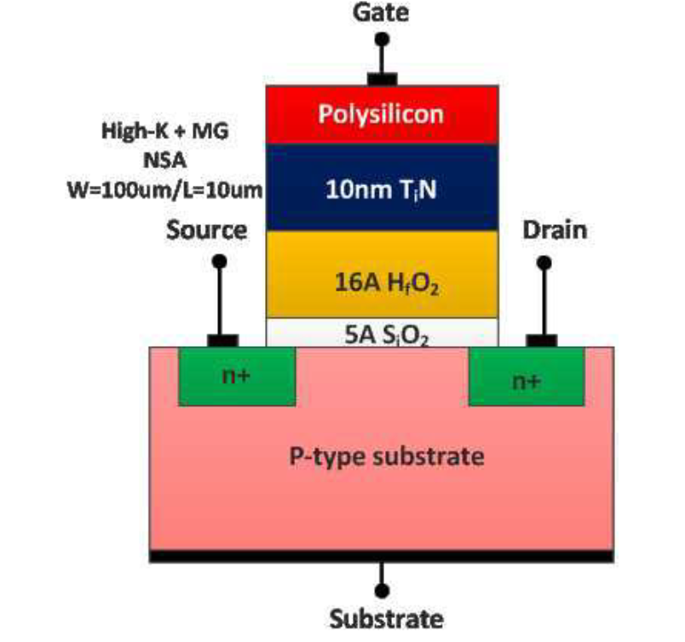
Cont.
Cross-section of the scaled NMOS transistors with 0.5 nm SiO2/1.6 nm HfO2 gate dielectric and 10 nm TiN gate electrodes (non-self-aligned, W = 100 um, L = 10 um).

Slide 19

Cont.

Slide 20
Results and discussion
increased junction current (10 times) in the Cii samples
comparison splits have been made for which the Cii in introduced after the dummy interfacial oxide growth. In this case, there is no significant performance improvement for either the NMOS or PMOS devices.
The modeled remote Coulomb scattering parameter and the surface roughness scattering parameter (β) show good agreement with the observed experimental values.
Simulations, based on theoretical modeling, show good agreement with experimental data obtained from a high-K NMOS device with ultra-thin oxide, for both DC I-V transfer and noise characteristics.
evaluated device performance and certain physical parameters of both NMOS and PMOS SiON MOSFET devices have been achieved.
For these devices, the gate leakage current does not have strong impact on the CV characteristics.
for high quality SiON devices, the surface roughness imposes a great impact on the carrier mobility.
Carbon ion-implantation (Cii) into CMOS device channels improves NMOS high-K, metal gate, device performance for replacement-gate, low power, technology
Notes:
As the devices scaled further, the surface roughness scattering parameter (β) will become more important in the 1/f noise due to the increased normal field.
Several experimental setups, involving automatic data acquisition,
siON Silicon oxynitride
The extracted results indicate an excellent interface quality between the SiON layer and the silicon substrate.
NMOS samples with Cii demonstrate a desirable decrease (-0.1 V) in Vt and improved electron mobility (10%) as compared with control samples without the Cii.

Slide 21
Future work
The present models have some fail in several instances; either the modeling parameters have been physically incorrect or the models have not been able to satisfactorily predict the noise behavior. The 1/f noise performance is sensitive to the choice of gate dielectric material. Devices using gate dielectrics with a high dielectric constant (high-k) can exhibit up to three orders of magnitude higher 1/f noise than those with thermally grown SiO2.

Slide 22
Future work
In this dissertation some future works are recommended such as:
The 1/f noise performance is sensitive to the choice of gate dielectric material. Devices using gate dielectrics with a high dielectric constant (high-k) can exhibit up to three orders of magnitude higher 1/f noise than those with thermally grown SiO2.
For further enhancement of device speed, continued downscaling of the device dimensions is necessary including the use of high-k gate dielectrics.
Improve a model for mobility fluctuations noise.
Study the random telegraph signal (RTS) noise of MOSFET devices, then compare with 1/f noise.
Develop quantum mechanical treatment of 1/f noise in PMOS devices.
we can Incorporate temperature capability in the current setup, and study the temperature dependent behavior of 1/f noise in nanoscaled MOSFET devices.
Extend the 1/f noise mechanisms and behavior in a single transistor to circuit and systems, and explore the noise benchmark methodology in modern VLSI systems.

Slide 23

Thank you 4 listening

